Slide 1
Countdown Timer
Mini-Project done using Tkinter (Python)

Slide 2
Why Tkinter?
I have past experiences with using Tkinter for building small GUI apps such as a calculator.
Since Tkinter is easy to learn and implement, I used it to build the minor project assigned to me: to build a countdown timer having the functionality to set, stop, reset and resume the timer.

Slide 3
Functionality:
First, the user has to set the time using the ‘set’ button. The time has to be set in the stdin.
Once the time is set, the user can click the ‘start’ button to activate the timer.
At any point of time, the user can stop the timer using the ‘stop’ button. If the time is stopped, the user can once again click the ‘start’ timer to resume the timer.
The ‘reset’ button allows the user to reset the timer to 00:00:00 seconds.

Slide 4
Concepts used:
This mini project helped me get acquainted with building GUI apps using Tkinter. It also helped me learn how to refer to resources available online, and how to read documentations of various languages to find what we want.
It helped me learn about Object-Oriented Programming (OOP) and how to implement it using Python.
I also learnt how to push commits to GitHub from the local repository, and interact with the CLI.

Slide 5
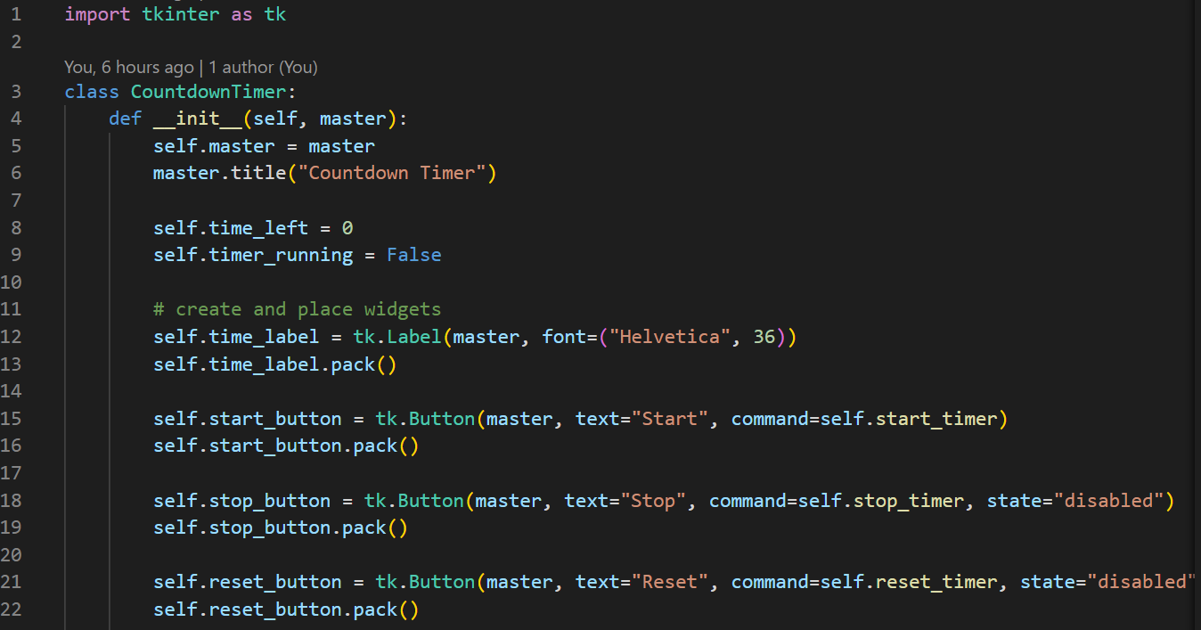
Code:

Slide 6
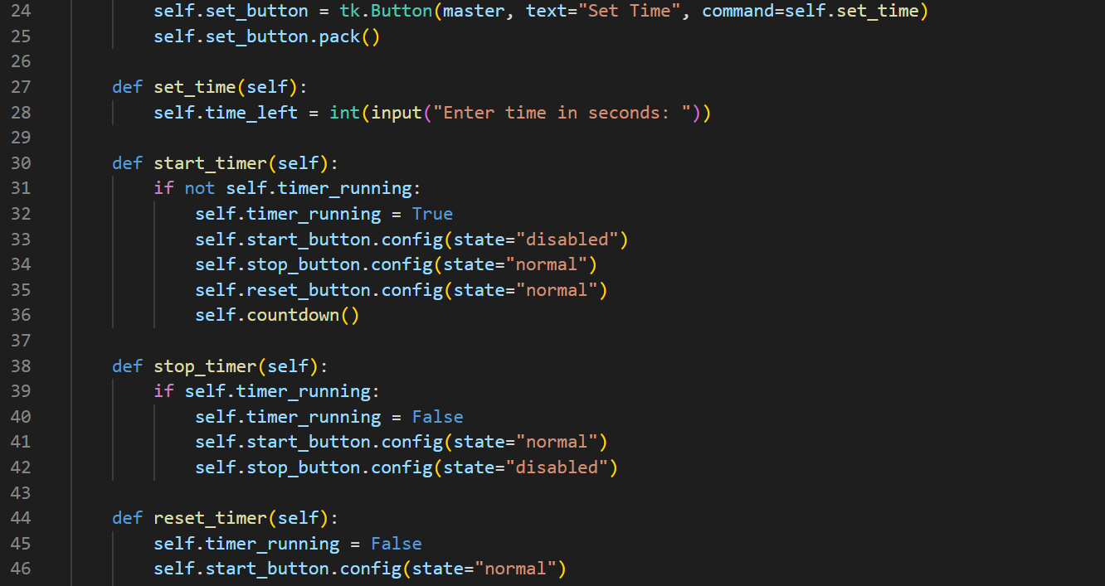

Slide 7
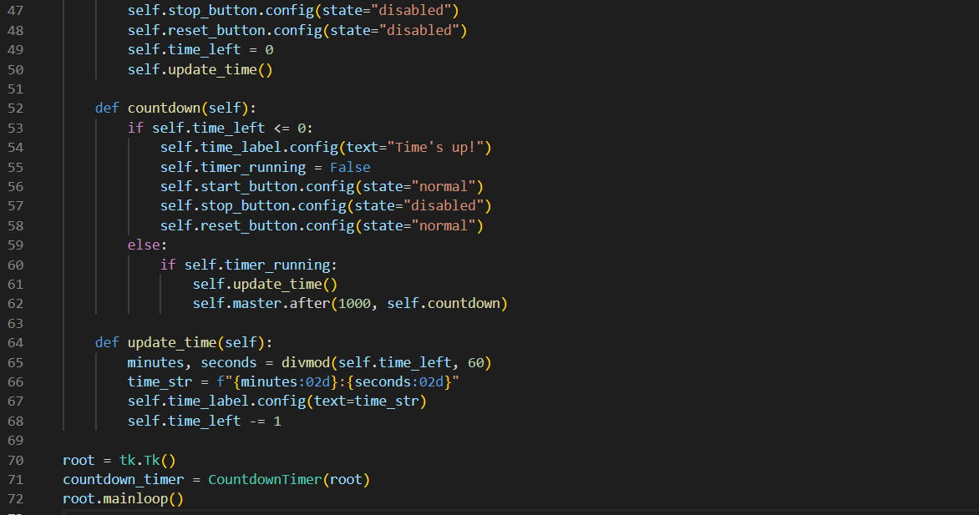

Slide 8
GitHub Repository Link:
I have maintained a GitHub repository for this project. The source code can be found at the following link:
https://github.com/VatsalBhuva11/countdown

Slide 9
Thank You!

